Slide 1
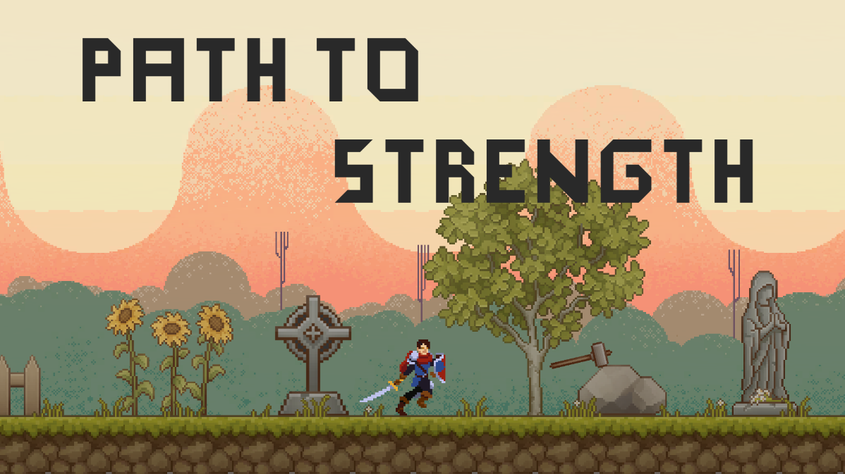
By Potato Team:
Xue Dingyuan(薛丁元), Liu Sicen(刘思岑),
Zhang Jingyuan(张静远), Hong Shanchuan(洪山川)
2022 NUS Summer Workshop SWS3007
Game Proposal Presentation

Slide 2
Background
“There's a big guy in the world... It will come to make trouble for you one day.”
“I guess we're cursed... We have to run laps here every day.”
“You have to find a way to survive. Those guys are getting stronger.”
“I have seen generations of brave men. Someone once got the better of the big guy and disappeared from the world.”
“If you want to get out of this world, you're gonna have to make your own——”
“Path To Strength”

Slide 3
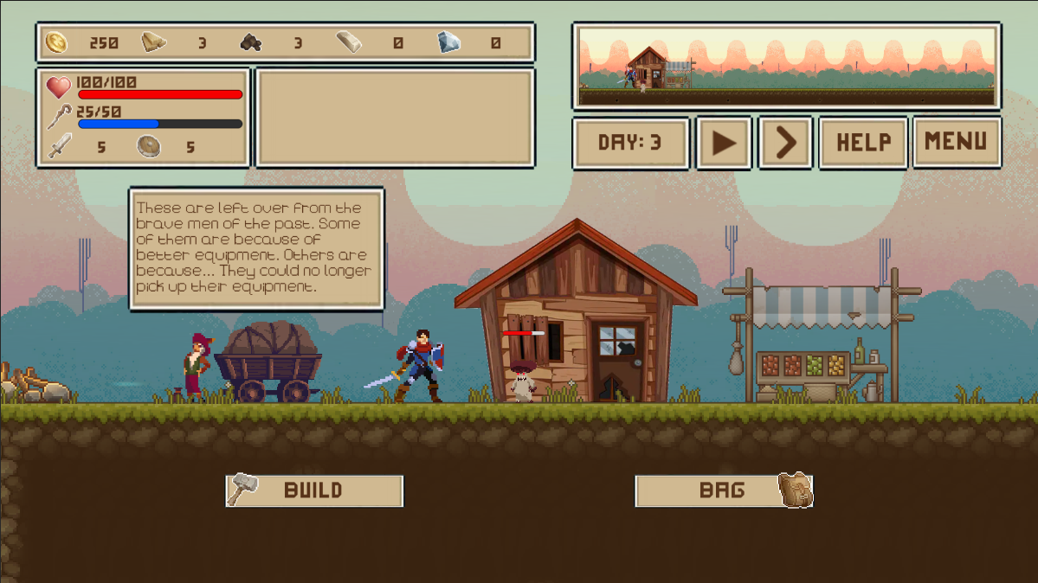
Main Scene

Slide 4

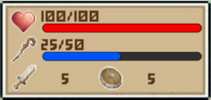
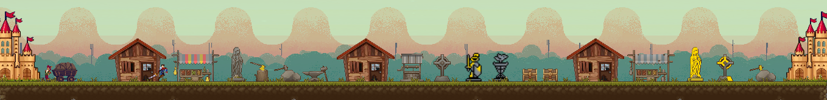
Gameplay
The hero automatically walks right and does all the work automatically every day.
You need to make him grow strong enough before the boss arrives.
Your job is to organize his day. To hunt monsters for golden coins, or to pick up resources, you just need to place the corresponding building in his path.
Plan your resources and buildings properly, you need enough resources to improve your hero's stats.

Slide 5











Buildings
Monster House: Hunt monsters for money. It is also getting stronger.
Treatment Station: Heal yourself by 50/100/200HP. By eating, it seems.
Magic Well: Increase your MP by 30/40/50. Magic flows in it.
Goddess Statue: Increase HP ceiling by 20/50/100. Goddess blesses you.
Cross Statue: Decrease MP ceiling by 15%/30%/40%. Reward for piety.
Knight Statue: Increase attack by 2/4/8. Knight gives you power.
Shield Statue: Increase defense by 2/4/8. Divine shield gives you power.
Logging Camp: Get 20/80 pieces of wood. It regenerates every day.
Quarry: Get 20/80 stones. It regenerates every day.
Iron Area: Get 50 irons. It regenerates every day.
Treasure Chest: Get 1 gem every day. It appreciates your creation.

Slide 6


















Equipments & Skills
Equipments:
Armor: Add HP and defense.
Boot: Add HP and defense.
Helmet: Add HP and defense.
Shield: Add denfense.
Weapon: Add attack.
Skills:
Bash: Bash the enemy. Make 3 times damage.
Holy Light: Attack enemy with a holy light. Add 15% of max HP.
This merchant will tell you something about the world everyday.

Slide 7


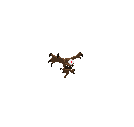
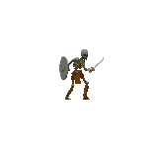

Monsters & Boss
Monsters: Living in the Monster House you created. Fighting heroes every day as he walk by. Defeating monsters gives you golden coins and resources.
Boss: Appear on certain days to fight the hero to the death. Very powerful.

Slide 8
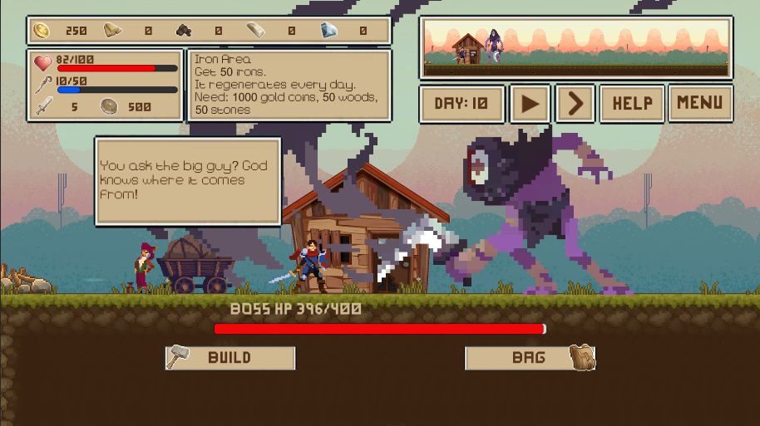
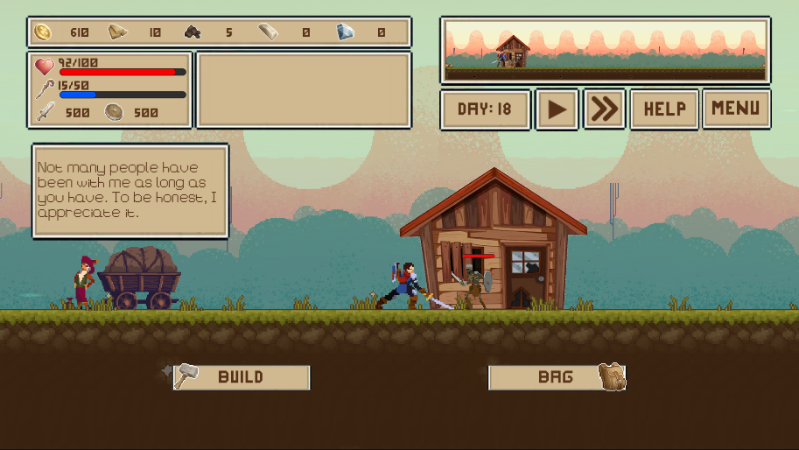
Modes & Days
In Easy mode, the Boss will comes first on 10th day, then it will be here every five days.
In Challenge mode, the Boss will comes on fixed 17th day and fight the hero to death.
Monsters in Monster House will get stronger and stronger, as well as the loot increasing.
Each monster house adds one monster every five days.

Slide 9
Operation
Keyboard:
Space: Pause and resume the game.
H: Speed up the game. There are three speeds.
A & D: Move the camera left and right when the game is paused.
Mouse:
Move screen when mouse on the screen side.
Move over anything to see informaytion.
Click anything.

Slide 10
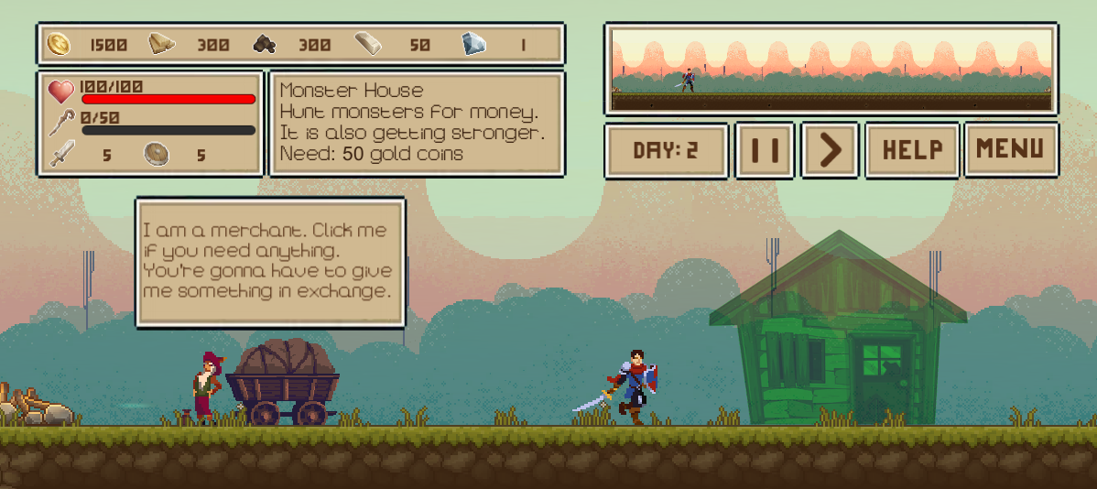
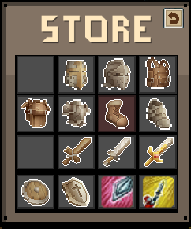
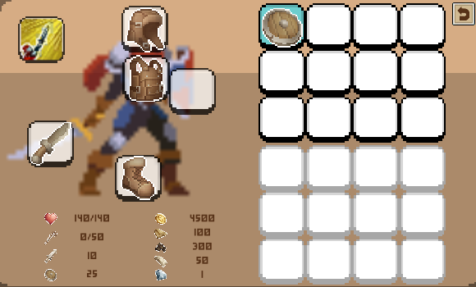
Show your resources, stats and information of object to which the mouse is pointing
Minimap, current game days and game options
Click merchant to buy equipment and skills.
Equip: Increases the hero's stats.
Skills: Automatically used when the MP bar is full. Every normal attack will restore MP.
Click Bag button to open the bag and equip equipment and skill.
Equipment can only be equipped on specific body parts.
Equipment and skills are only effective when they are equipped.
How to build:
Click the Build button and select a building.
Click left mouse button to build, right mouse button to cancel.
Red means wrong position or lacking resources.

Slide 11
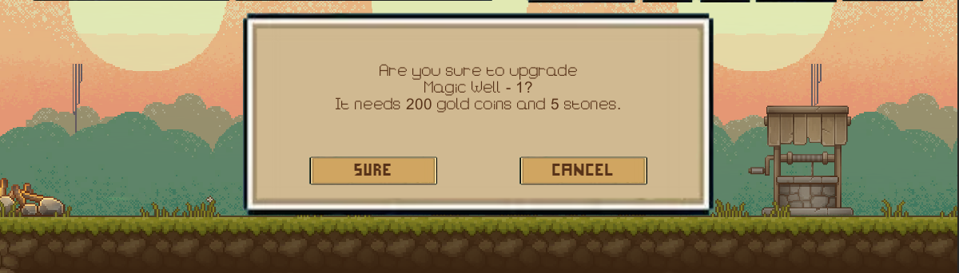
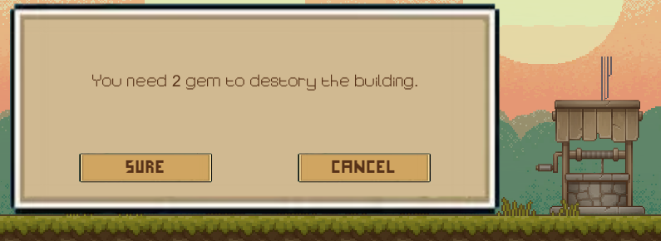
Click left mouse on home to upgrade it.
An adequate level of home is a prerequisite for some building upgrades.
Click left mouse on building to upgrade it.
It gets a new look and more powerful effects.
Click right mouse on building to destory it.
The amount of gems needed to dismantle the building will gradually increase.

Slide 12
Fun points
Urban construction, survival strategies, resource management
Customize your own path to strength! Try different development road.
The loot of monsters is a bit random.

Slide 13
THANK YOU
Game Proposal Presentation by Potato Team:
Xue Dingyuan(薛丁元), Liu Sicen(刘思岑), Hong Shanchuan(洪山川), Zhang Jingyuan(张静远)
2022 NUS Summer Workshop SWS3007

